Slide 1
A First Book of ANSI C Fourth Edition
Chapter 12
Structures

Slide 2
Objectives
Single Structures
Arrays of Structures
Passing and Returning Structures
Unions (Optional)
Common Programming and Compiler Errors

Slide 3
Introduction
Each data item listed in Figure 12.1 is an entity by itself, called a data field
Together, all the data fields form a single unit called a record
In C, a record is referred to as a structure

Slide 4
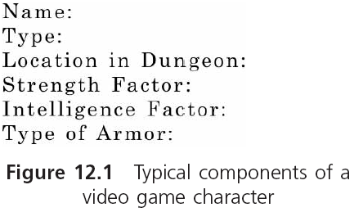
Introduction (continued)

Slide 5
Introduction (continued)
A structure’s form consists of the symbolic names, data types, and arrangement of individual data fields in the record
The structure’s contents consist of the actual data stored in the symbolic names

Slide 6
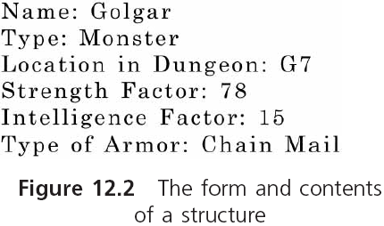
Introduction (continued)

Slide 7
Single Structures
Structure definition in C:
struct
{
int month;
int day;
int year;
} birth;
Reserves storage for the individual data items listed in the structure
The three data items are the members of the structure
Assigning actual data values to the data items of a structure is called populating the structure

Slide 8
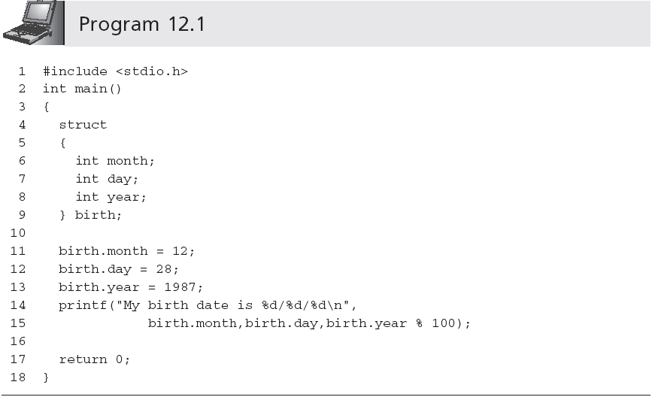
Single Structures (continued)
spacing of a structure definition is not rigid

Slide 9
Single Structures (continued)
Multiple variables can be defined in one statement
struct {int month; int day; int year;} birth, current;
Common to list the form of the structure with no following variable names
The list of structure members must be preceded by a user-selected structure type name
struct Date
{
int month;
int day;
int year;
};

Slide 10
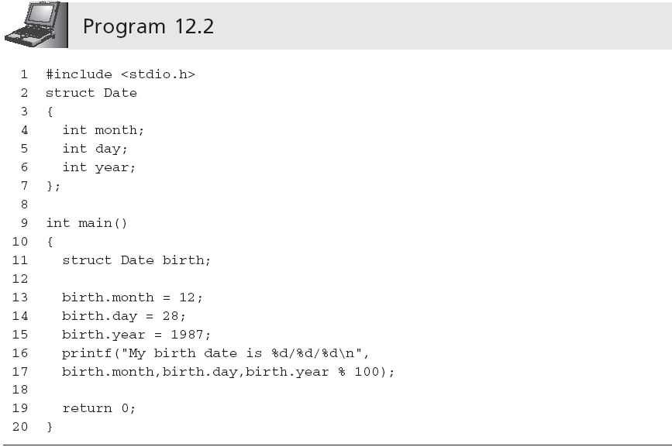
Single Structures (continued)
By convention the first letter of user-selected structure type names is uppercase

Slide 11
Single Structures (continued)
Initialization of structures follows the same rules as for the initialization of arrays:
struct Date birth = {12, 28, 1987};
Structure members can be of any data type
struct PayRecord
{
char name[20];
int idNum;
double regRate;
double otRate;
};
struct PayRecord employee = {"H. Price", 12387, 15.89, 25.50};

Slide 12
Single Structures (continued)
Advantage of structures is when the same structure type is used in a list many times
Individual members can be arrays and structures
struct
{
char name[20];
struct Date birth;
} person;
Example: person.name[4]

Slide 13
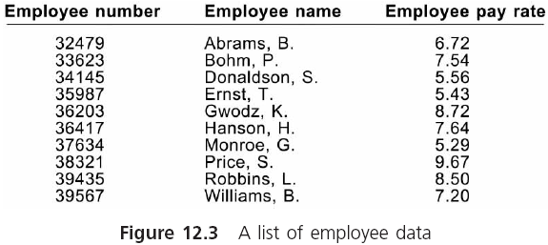
Arrays of Structures

Slide 14
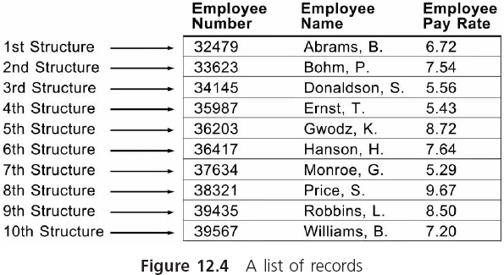
Arrays of Structures (continued)

Slide 15
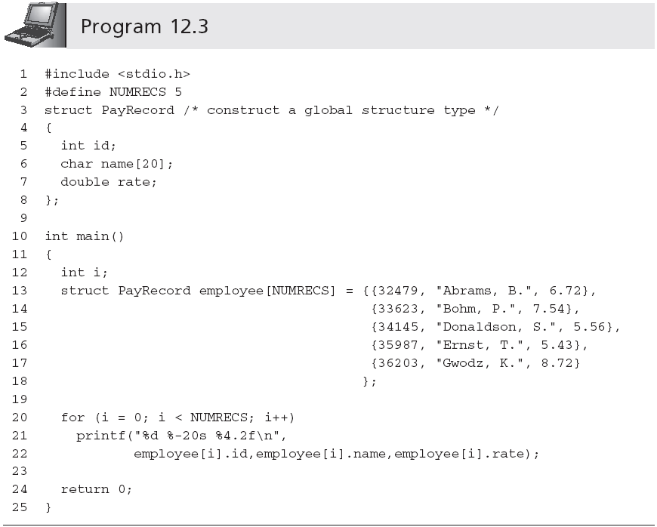
Arrays of Structures (continued)
Inner braces are not necessary

Slide 16
Arrays of Structures (continued)
Without explicit initializers, the numeric elements of both static and external arrays or structures are initialized to 0 (or nulls)
An inferior alternative to an array of structures is parallel arrays
Parallel arrays are two or more arrays, where each array has the same number of elements and the elements in each array are directly related by their position in the arrays
They are rarely used any more

Slide 17
Passing and Returning Structures
Individual structure members may be passed to a function in the same manner as any scalar variable
display(emp.idNum)
calcPay(emp.payRate,emp.hours);
On most compilers, complete copies of all members of a structure can also be passed to a function by including the name of the structure as an argument to the called function
calcNet(emp);

Slide 18
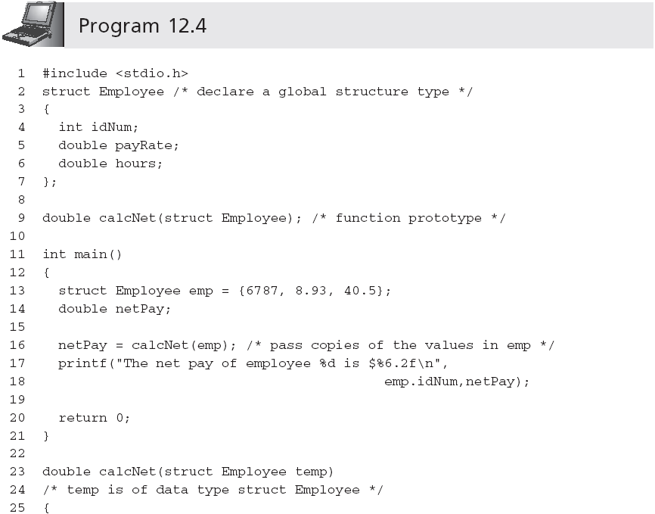
Passing and Returning Structures (continued)
Although the structures in main() and calcNet()
use the same globally defined structure type,
this is not strictly necessary (although it is preferable)
Pass by value

Slide 19
Passing and Returning Structures (continued)
A structure can be passed by reference
calcNet(&emp);
double calcNet(struct Employee *pt)
(*pt).idNum or pt->idNum

Slide 20
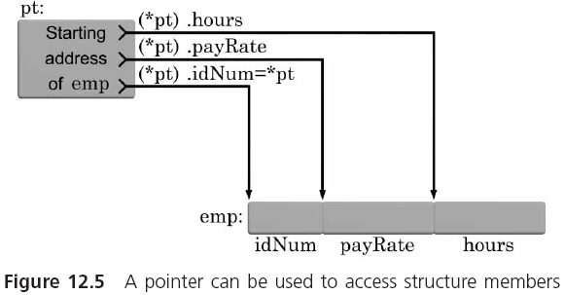
Passing and Returning Structures (continued)

Slide 21
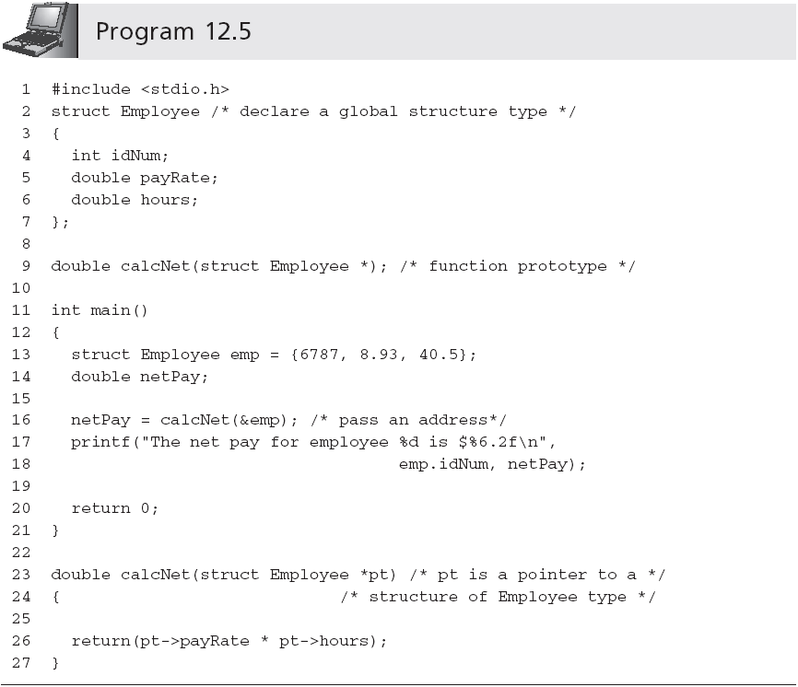
Passing and Returning Structures (continued)

Slide 22
Passing and Returning Structures (continued)
++ and -- can be applied to structures
++pt->hours
(pt++)->hours
(++pt)->hours

Slide 23
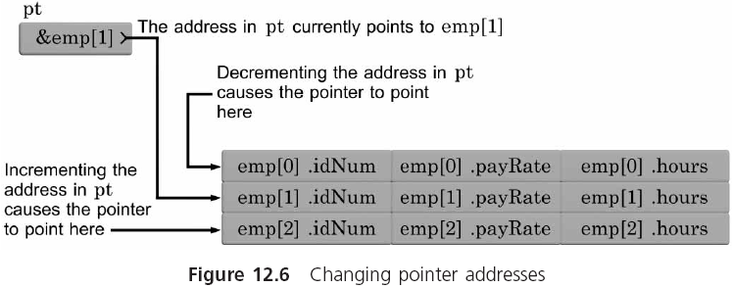
Passing and Returning Structures (continued)

Slide 24
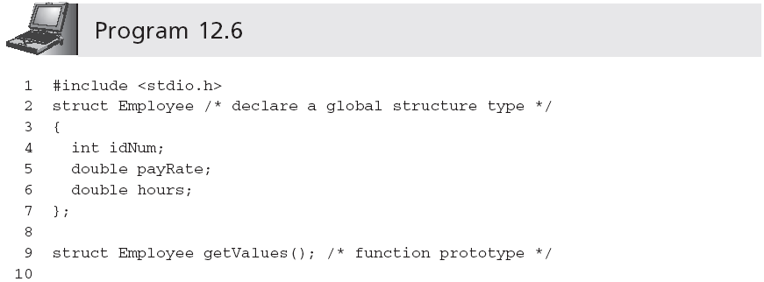
Returning Structures

Slide 25
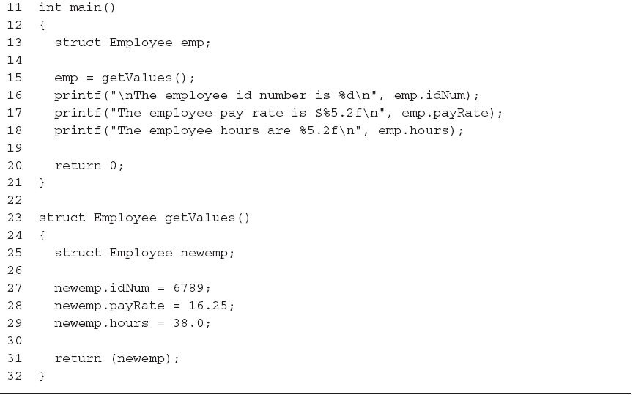
Returning Structures (continued)

Slide 26
Unions
A union is a data type that reserves the same area in memory for two or more variables
union
{
char key;
int num;
double price;
} val;
Each of these types, but only one at a time, can actually be assigned to the union variable
A union reserves sufficient memory locations to accommodate its largest member’s data type

Slide 27
Unions (continued)
Individual union members are accessed using the same notation as structure members
Typically, a second variable keeps track of the current data type stored in the union
switch(uType)
{
case ‘c’: printf("%c", val.key);
break;
case ‘i’: printf("%d", val.num);
break;
case ‘d’: printf("%f", val.price);
break;
default : printf("Invalid type : %c", uType);
}

Slide 28
Unions (continued)
A type name can be associated with a union to create templates
union DateTime
{
long days;
double time;
};
union DateTime first, second, *pt;
Pointers to unions use the same notation as pointers to structures
Unions may be members of structures and arrays; structures, arrays, and pointers may be members of unions

Slide 29
Unions (continued)
struct
{
char uType;
union
{
char *text;
double rate;
} uTax;
} flag;
rate is referenced as flag.uTax.rate
The first character of the string whose address is stored in the pointer text is accessed as *flag.uTax.text

Slide 30
Common Programming Errors
Attempting to use structures and unions, as complete entities, in relational expressions
Assigning an incorrect address to a pointer that is a member of a structure or union
Storing one data type in a union and accessing it by the wrong variable name can result in an error that is particularly troublesome to locate

Slide 31
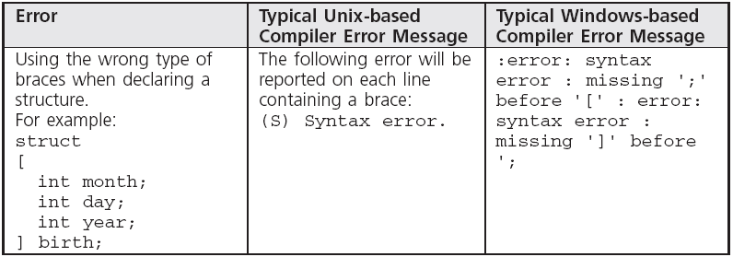
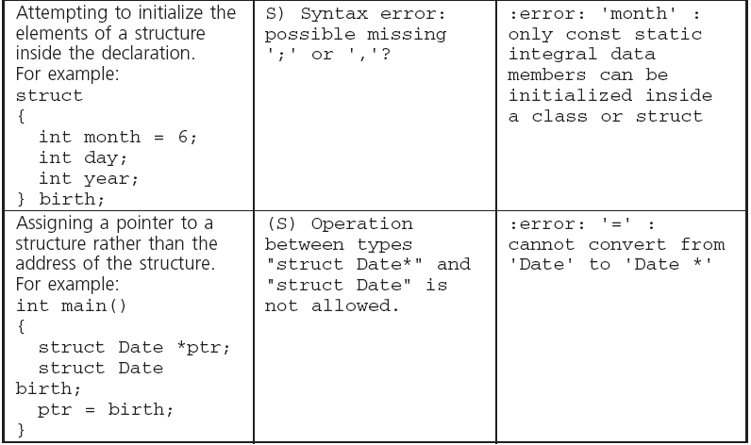
Common Compiler Errors

Slide 32
Summary
A structure allows individual variables to be grouped under a common variable name
A structure type name can be used to create a generalized structure type describing the form and arrangement of elements in a structure
Structures are particularly useful as elements of arrays

Slide 33
Summary (continued)
Individual members of a structure are passed to a function in the manner appropriate to the data type of the member being passed
Structure members can be any valid C data type, including structures, unions, arrays, and pointers
Unions are declared in the same manner as structures

